Slide 1
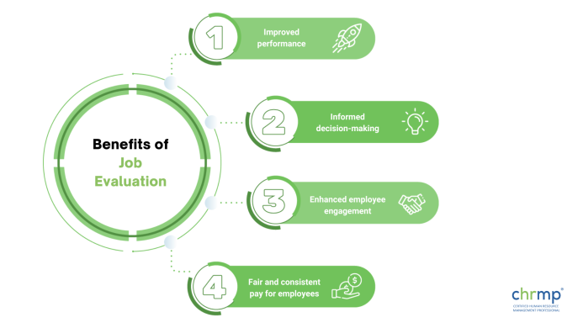
JOB EVALUATION
MERIT RATING
INDUSTRIAL ACCIDENTS

Slide 2
JOB EVALUATION
Job Evaluation is a systematic process of evaluating different jobs of an organization.
Depending upon the characteristics and requirements of a job, job evaluation determines its relative worth and attaches a value to it.
These relative values of a jobs assist in deciding wages rates and salaries for different jobs.
Job evaluation deals with job only and is in no way concerned with the persons doing these jobs.

Slide 3
ROLE OF JOB EVALUATION
Decide the relative values of different jobs in an organization.
Helps to formulate an appropriate and uniform wage structure .
Clarifies the responsibility and authority concerned with each job .
Provide a basis of recruitment, selection, training, promotion and transfer of the employees .
Improves employer-employee relationships .
Minimize the labour turnover .

Slide 4
METHODS OF JOB EVALUATION
Ranking method
Classification method
Factor comparison method
Point method

Slide 5
MERIT RATING
Merit Rating is a systematic and orderly approach to assess the relative worth of an employee working in an organization in terms of his job performance, integrity, leadership, intelligence, behaviour etc.
Merit Rating provides a record of the worth of employees; therefore, can be put on the most appropriate jobs depending upon their capabilities.
Merit Rating unfolds the limitations of an employee and thus helps in employee improvement.

Slide 6
MERIT RATING
Wage-increase
Promotion
Special Assignments
Training
Transfer
Discharge

Slide 7
METHODS OF MERIT RATING
Rating Scale Method
Check List Method
Employee Comparison Method

Slide 8
INDUSTRIAL ACCIDENTS
Under the Factories Act, 1948, an industrial accident has been defined as “an occurrence in an industrial establishment causing bodily injury to a person which makes him unfit to resume his duties in the next 48 hours.”
An industrial accident is an unexpected occurrence in an industrial establishment causing injury to one or more persons.
It is the sudden or unexpected event which creates the obstacles in the path of smooth conduct of work and the worker is unable to perform his work either temporarily or permanently is called an accident.

Slide 9
ENVIRONMENTAL CAUSES OF ACCIDENTS
Poor lighting
Low visibility is a common cause of slips, trips, and falls.
Ambient temperature
If a workplace is too hot, overheating can occur.
Air pollution
Breathing issues can develop if a workplace has poor ventilation and/or air pollution.
Sound pollution
The sound in a workplace can cause injury to a worker’s hearing.

Slide 10
MECHANICAL CAUSES OF INDUSTRIAL ACCIDENTS
Broken or damaged machine
Parts can be easily broken or damaged if made of poor-quality metal.
Power failure
Total or partial power failure can lead to serious injury.
Fire or explosion
Cooling failure or a small spark can lead to a mechanical fire or explosion.
Wear and tear
The older machine, the more wear and tear on the parts which can lead to a higher risk of mechanical accident.

Slide 11
HUMAN FACTORS THAT CAUSE ACCIDENTS
Poor housekeeping
An unkempt work space can lead to slips, trips, and falls.
Fatigue
When a body is tired, injury is more likely to occur. • Overexertion – Overexertion injuries are the most common type of workplace injury.
Stress
Workers who are stressed are often more distracted and of greater risk of injury.
Dehydration
It is important to consume enough water to ensure you body functions properly.
Improper Lifting
Lower back strains and shoulder injuries are common among workers who use improper lifting techniques.

Slide 12
EFFECTS OF INDUSTRIAL ACCIDENTS
Loss to Industry
Loss to workers
It will adversely affect the family
Loss to customers
Increase in production costs
Loss to society

